Slide 1
Custom Babies: The Ethical Dilemma of Genetic Editing
Module 1: Unethical Biology

Slide 2
Introduction

Slide 3
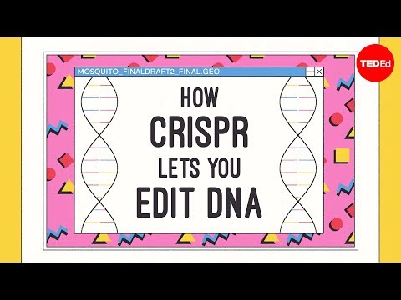
Gene Editing Review
While watching the video, consider the following questions:
What is CRISPR-Cas9?
How does CRISPR-Cas9 gene editing work?
What are the potential uses of CRISPR-Cas9 genetic editing technology?
Notes:
https://www.youtube.com/watch?v=jAhjPd4uNFY
Pros: Goes over history of genetic modification, how CRISPR works, research as of 2016 on what can be done in humans, designer babies potentials, pros and cons of designer babies, solving aging, limitations of CRISPR
Cons: Long (15min), old (2016)
https://www.youtube.com/watch?v=6tw_JVz_IEc
Pros: short video, recent (2019) Goes over review of DNA, potentials, how CRISPR works,
Cons: only science perspective and very sciencey,
https://www.youtube.com/watch?v=kFFyeHJDI50%E2%80%8B
Pros: Recent (2019) Relates to news, reviews DNA/genetics, how CRISPR works, why experimentally the He research was problematic (limitations of CRISPR in humans) and the details of what they did, need for next steps,
Cons: long (12 min), very sciencey (the most out of the 3), ADVERTISEMENT AT THE END BOOO

Slide 4
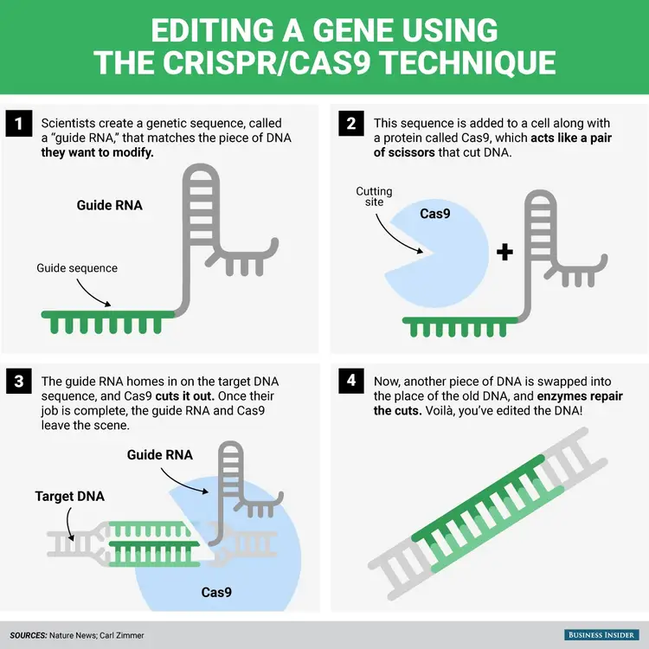
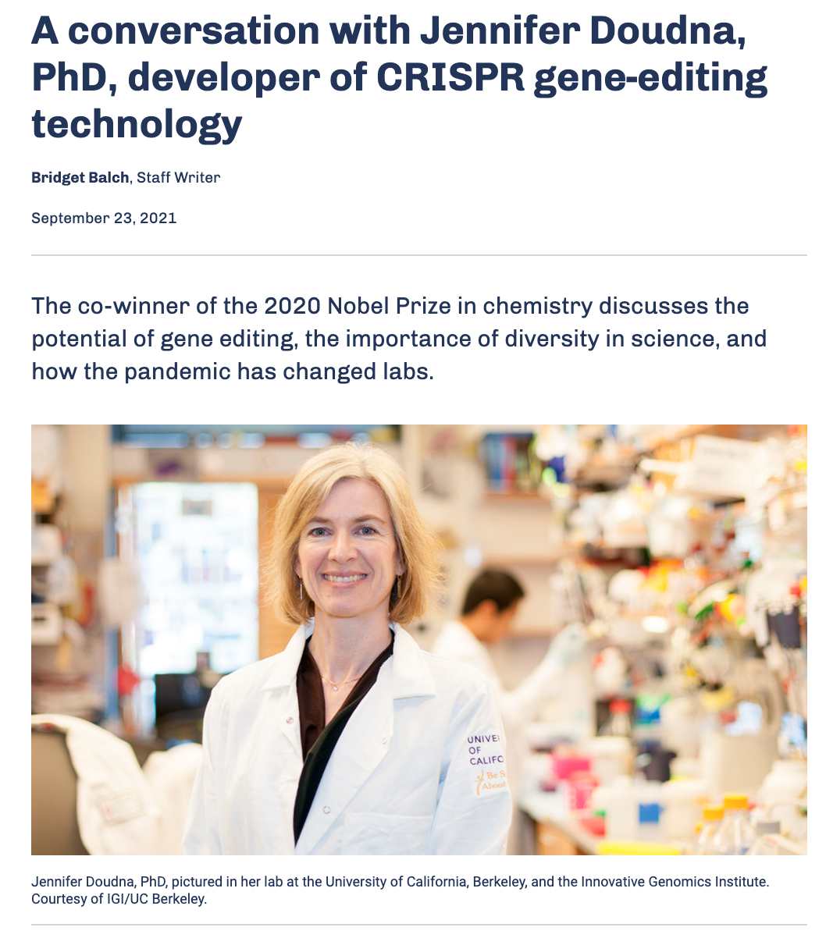
CRISPR Technology
(Balch, 2021)
(Roach, Business Insider, 2015)

Slide 5
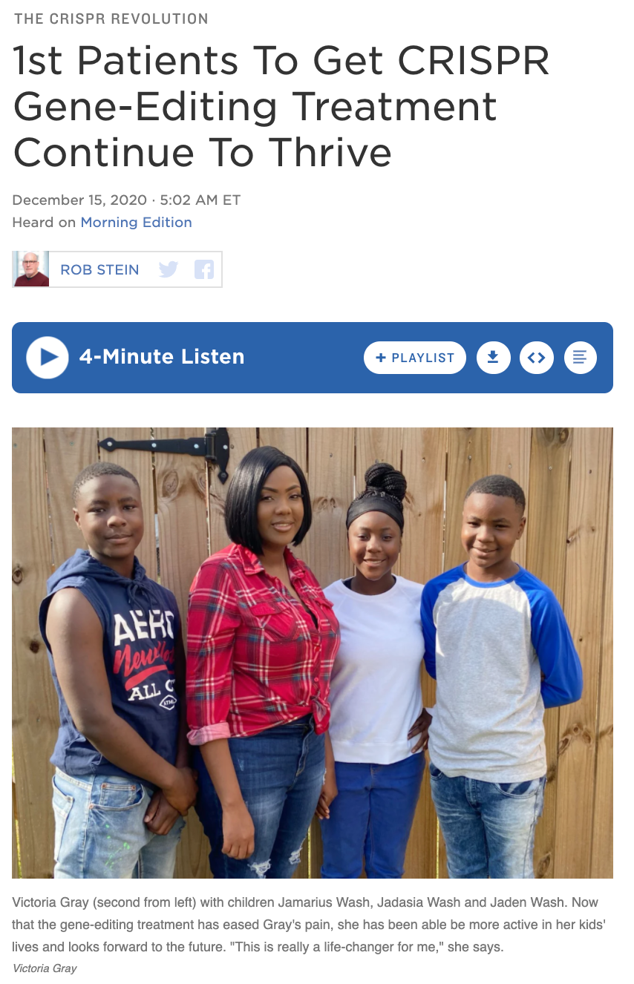
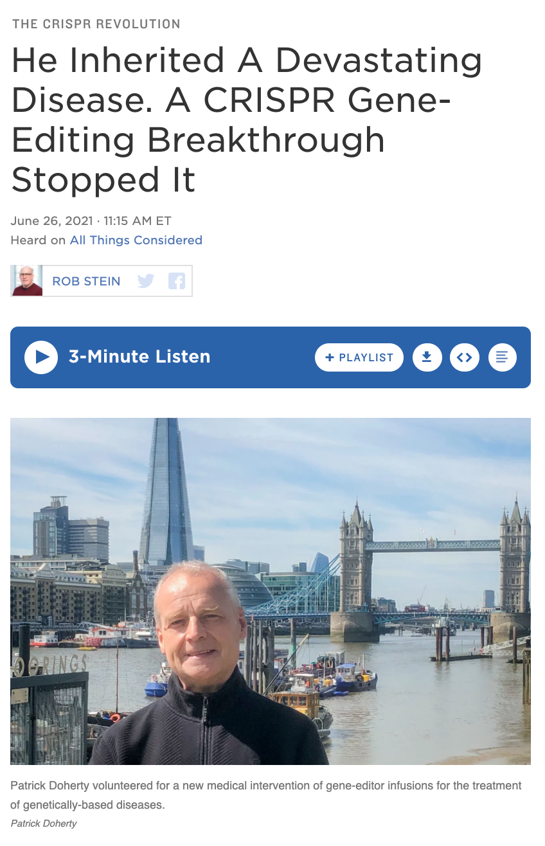
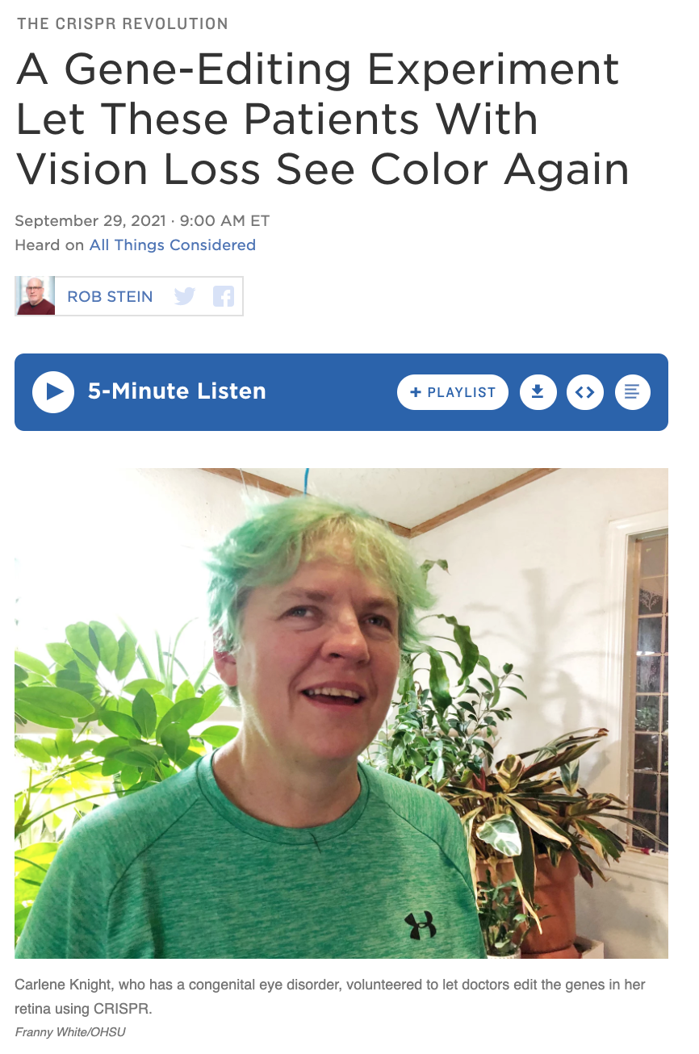
CRISPR in Humans
(Stein, 2021)
(Stein, 2020)
(Stein, 2021)

Slide 6
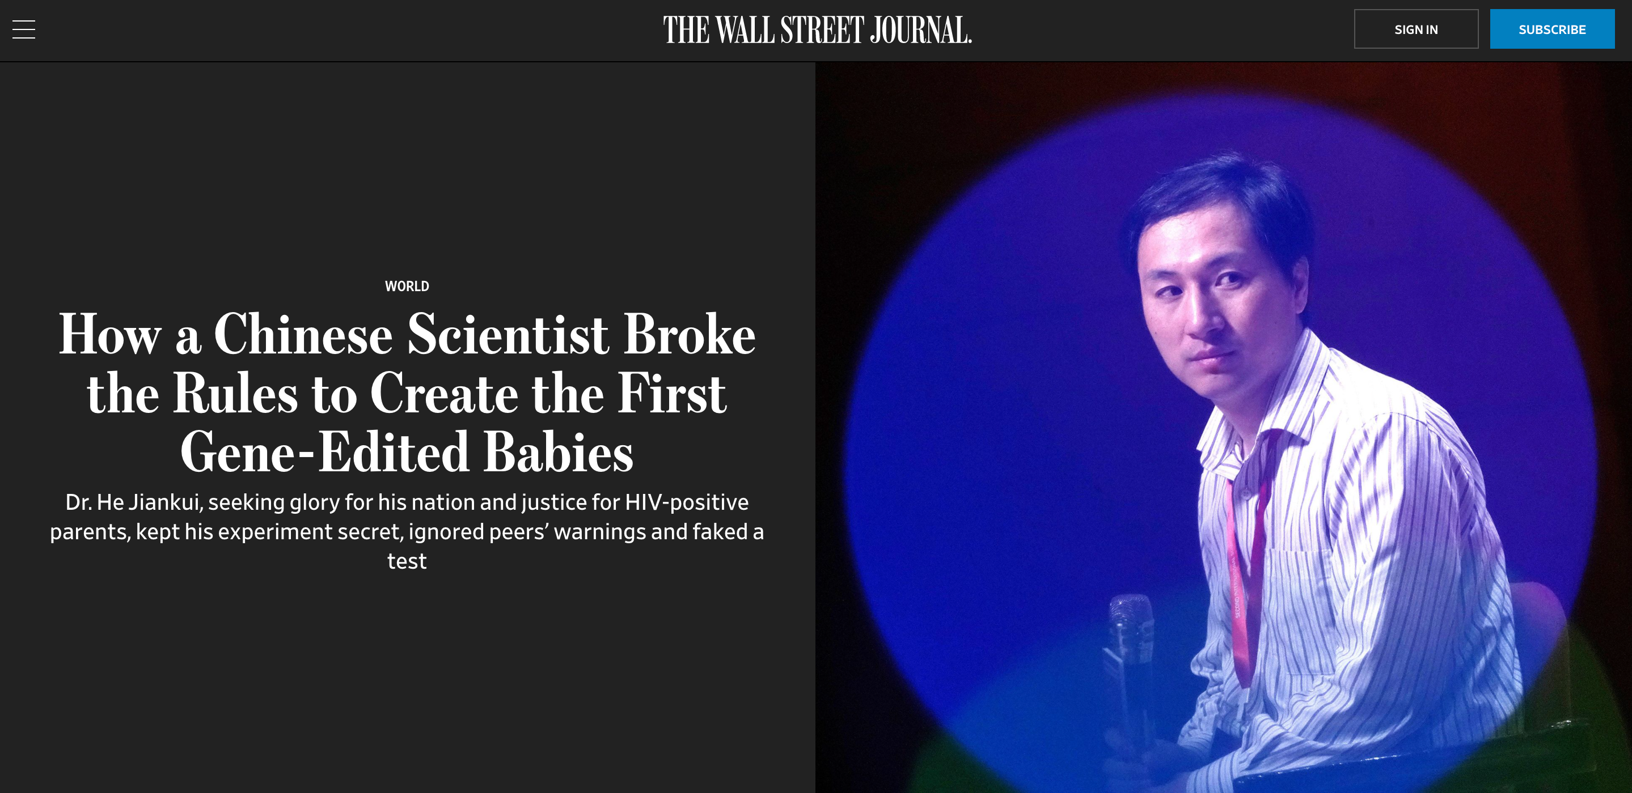
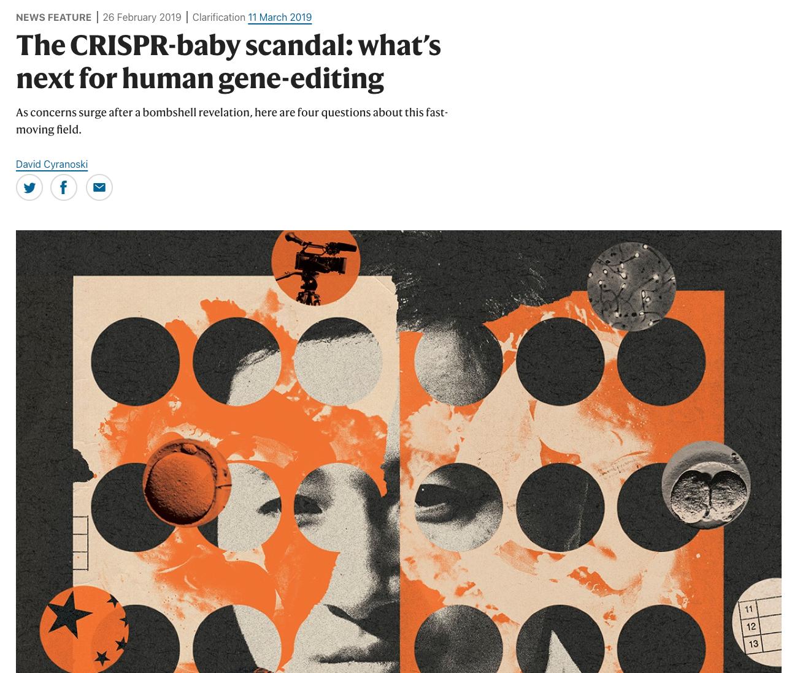
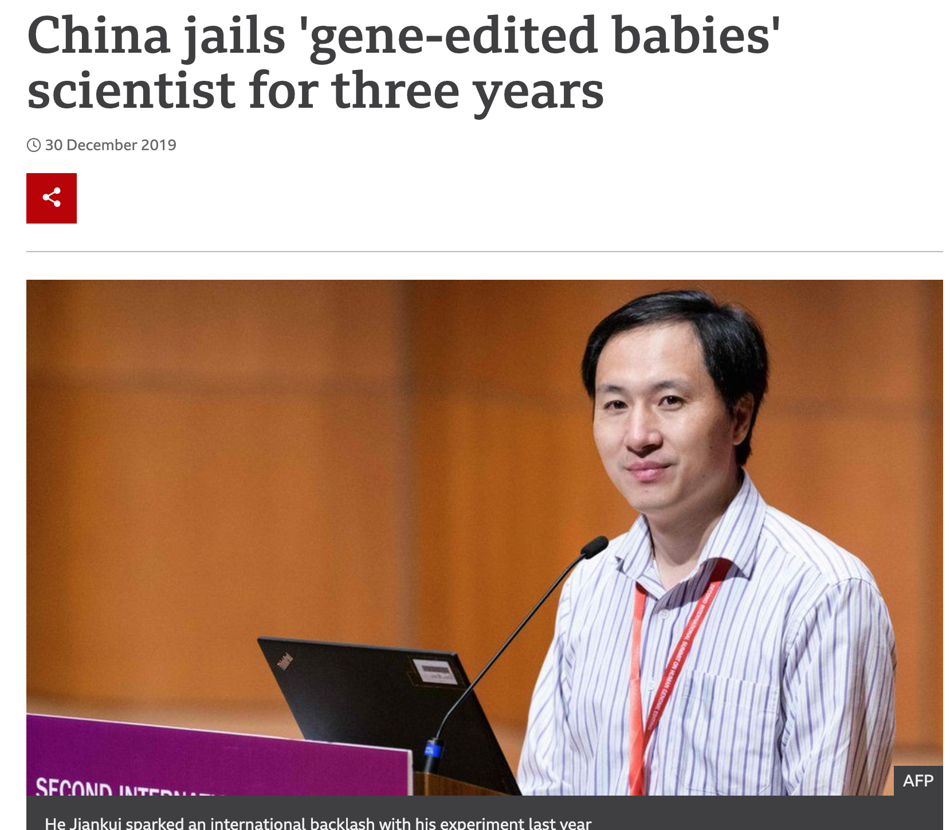
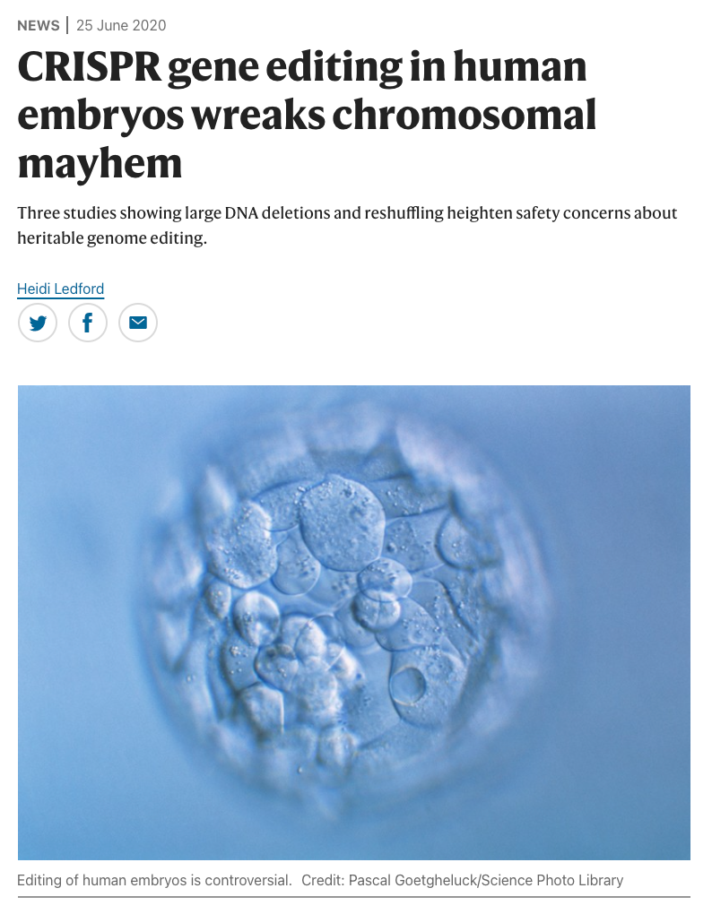
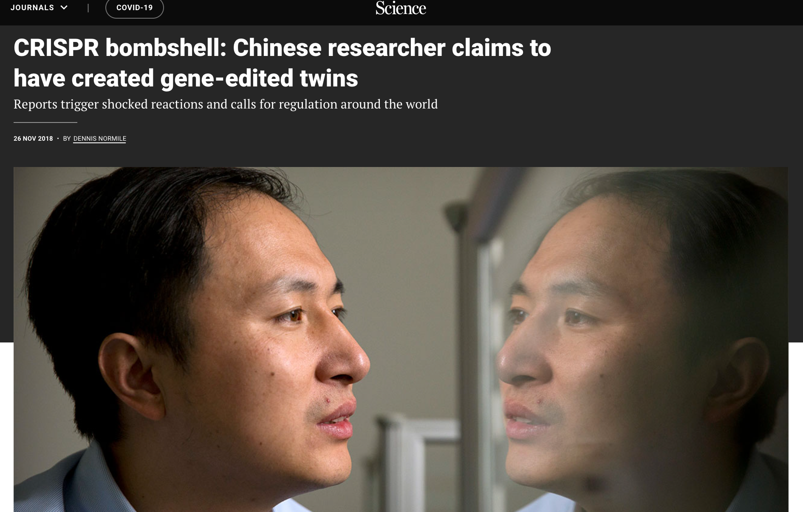
CRISPR in Human Embryos (Prenatal)

Slide 7
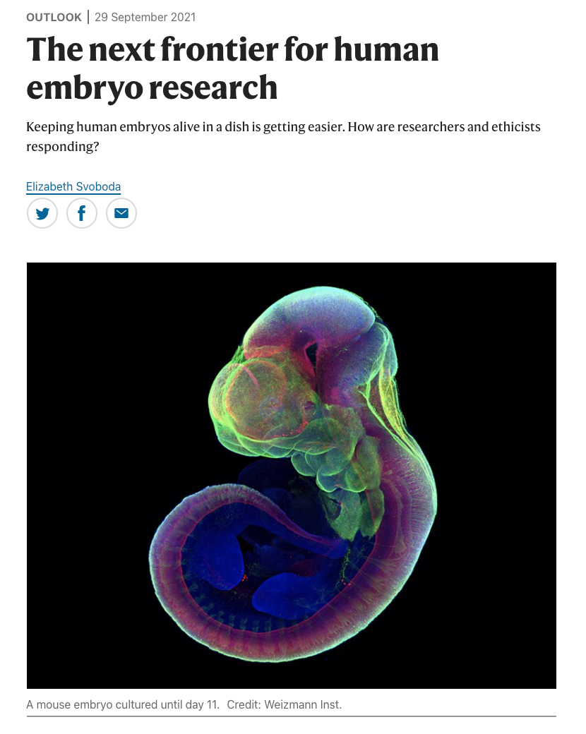
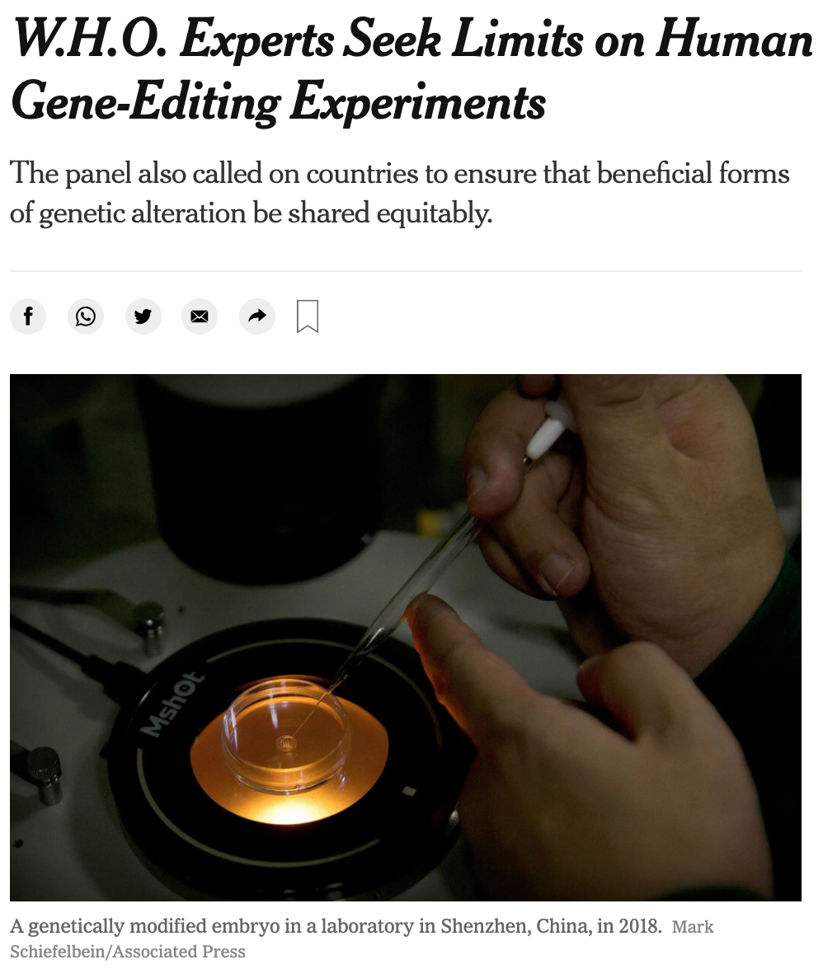
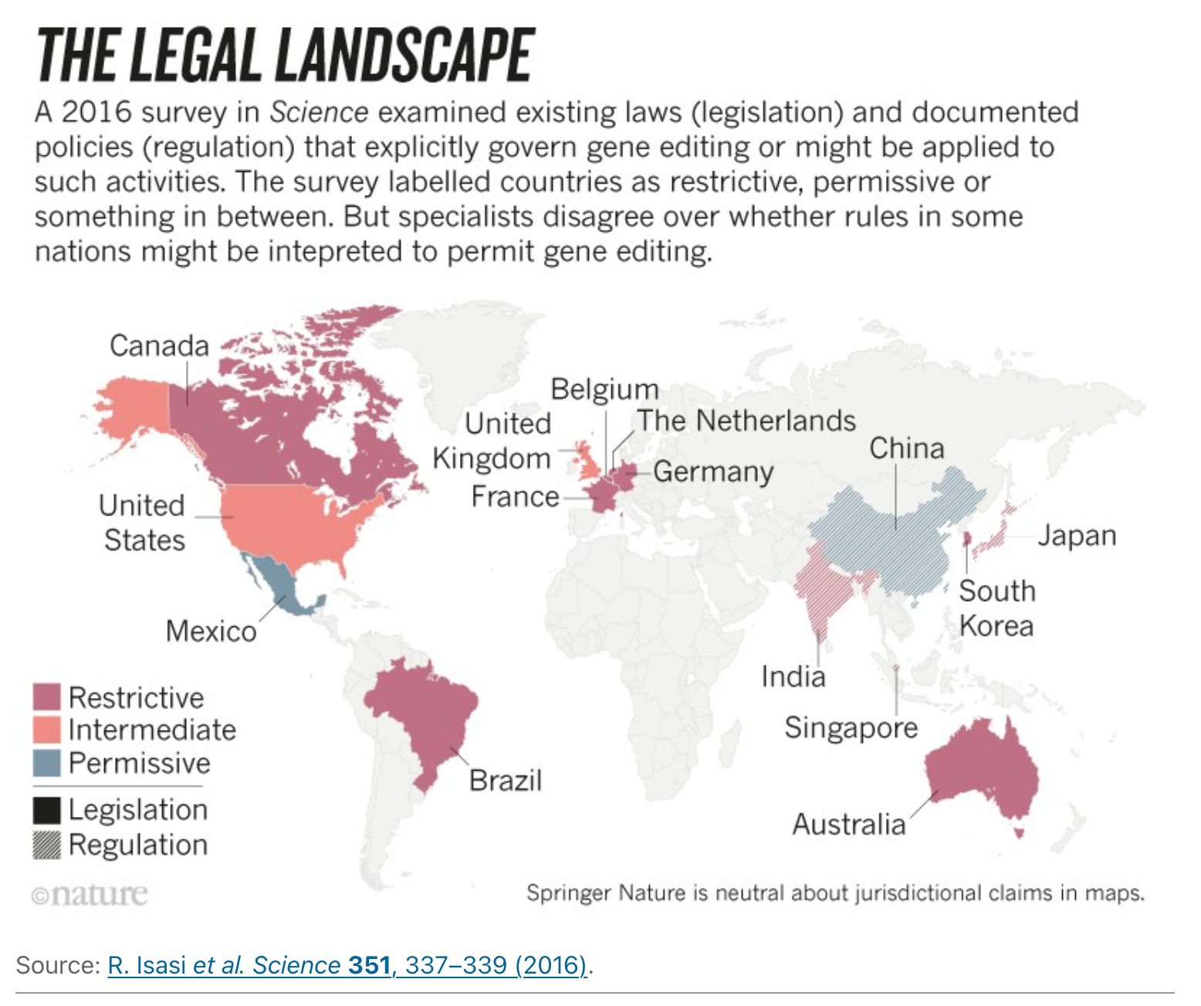
CRISPR in Human Embryos Ethics
Currently, CRISPR in humans and human embryos is under debate in the scientific community and other communities at large. So what is the ethical decision?

Slide 8
Case perspectives activity

Slide 9
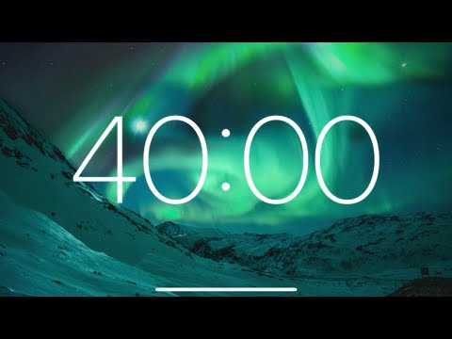
Case analysis and reflection
In your groups, you will be given two separate cases that have to do with using CRISPR gene-editing technology.
Read each case.
Discuss the guiding questions for each.
Record your thoughts as group members on your handout.
Be prepared to share your concluding thoughts

Slide 10
Conclusion

Slide 11
Discussion
In which cases, if any, should prenatal genetic editing technology be used? Why or why not? (Consider societal/cultural and scientific reasons)
How does society impact genetic- editing science?
How does genetic-editing science impact society?

Slide 12
Assessment

